Slide 1
Indian Agriculture Analysis with PowerBI
MENTORNESS TASK – 2 (PROJECT -2)
Batch - MIP-DA-04
by AKASH A

Slide 2
Introduction
In this project, we're using Power BI to analyze Indian agriculture data district-wise and year-wise. We're exploring information on various crops like rice, wheat, and pulses, focusing on areas, production, and yields. Our goal is to uncover trends and patterns in agricultural practices to aid decision-making for sustainable farming.

Slide 3
Events – Data analysis process
1st Event | 2nd Event | 3rd Event | 4th Event | 5th Event
Data Collection | Data Cleaning | Data Transfer to PowerBI | Creating charts | Data Visualizations

Slide 4
Problem Statement
This project aims to conduct a comprehensive analysis of Indian agriculture, focusing on district-wise and year-wise data. The dataset provides detailed information on various crops, their areas, production, and yields across different districts and years. The goal is to leverage Power BI to create interactive visualizations that uncover trends, patterns, and disparities in agricultural practices, enabling stakeholders to make informed decisions for sustainable farming and resource allocation.

Slide 5
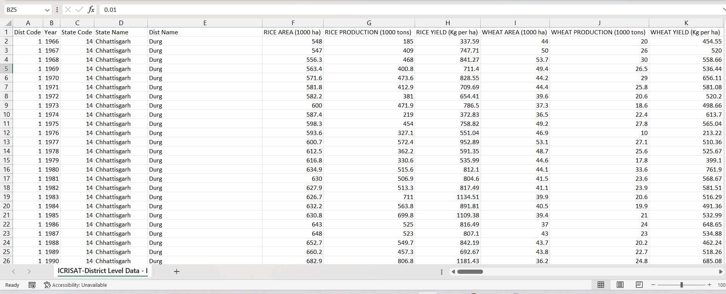
Dataset Description
The dataset encompasses a wide range of agricultural variables, including crop areas, production quantities, and yields for different crops such as rice, wheat, sorghum, millets, pulses, oilseeds, sugarcane, and more.

Slide 6
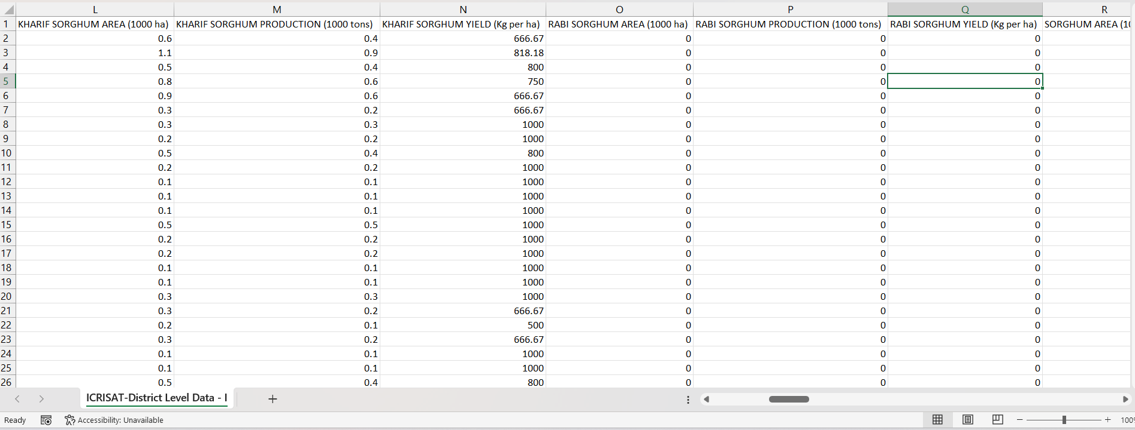

Slide 7
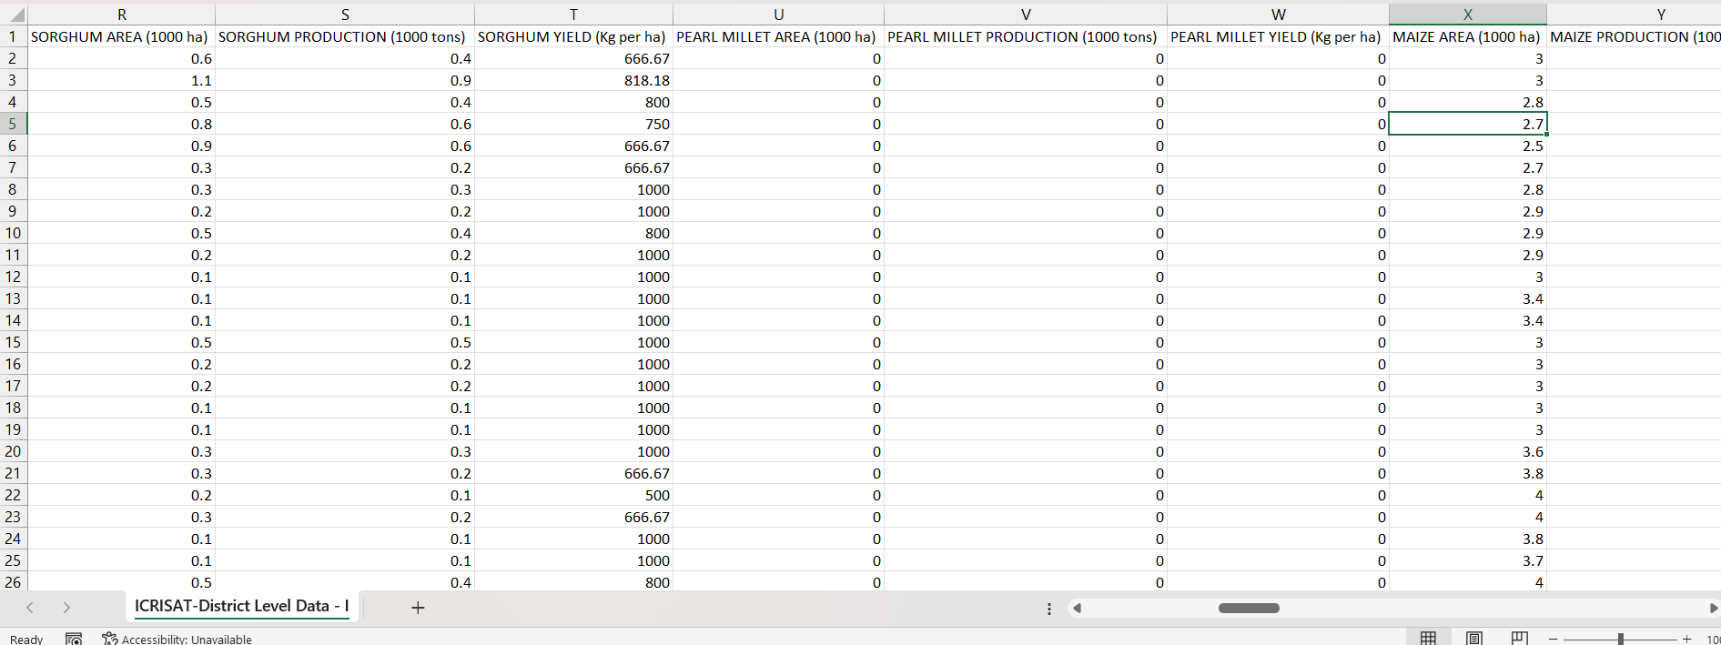

Slide 8
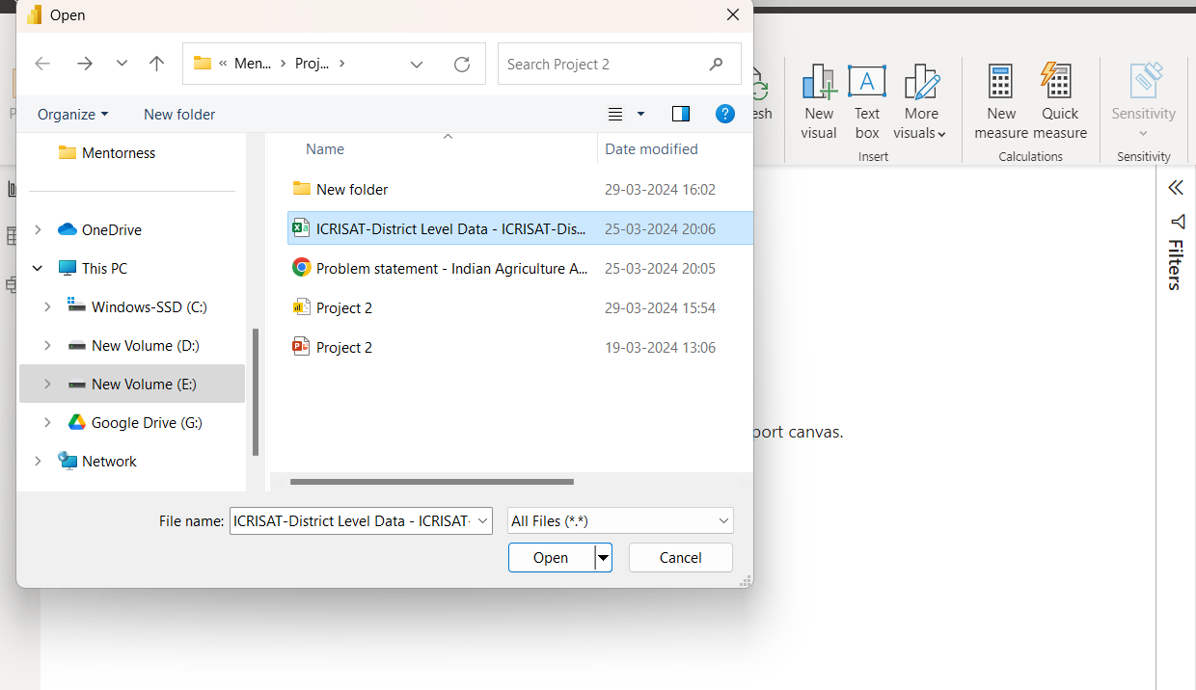
load the data into PowerBI

Slide 9
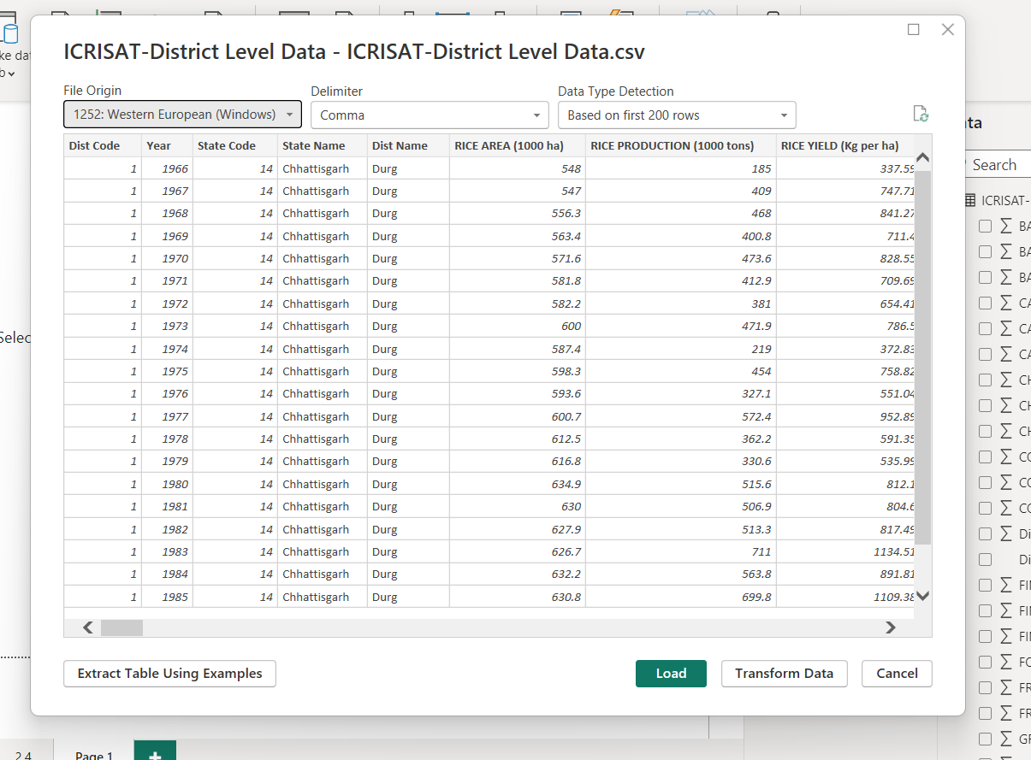

Slide 10
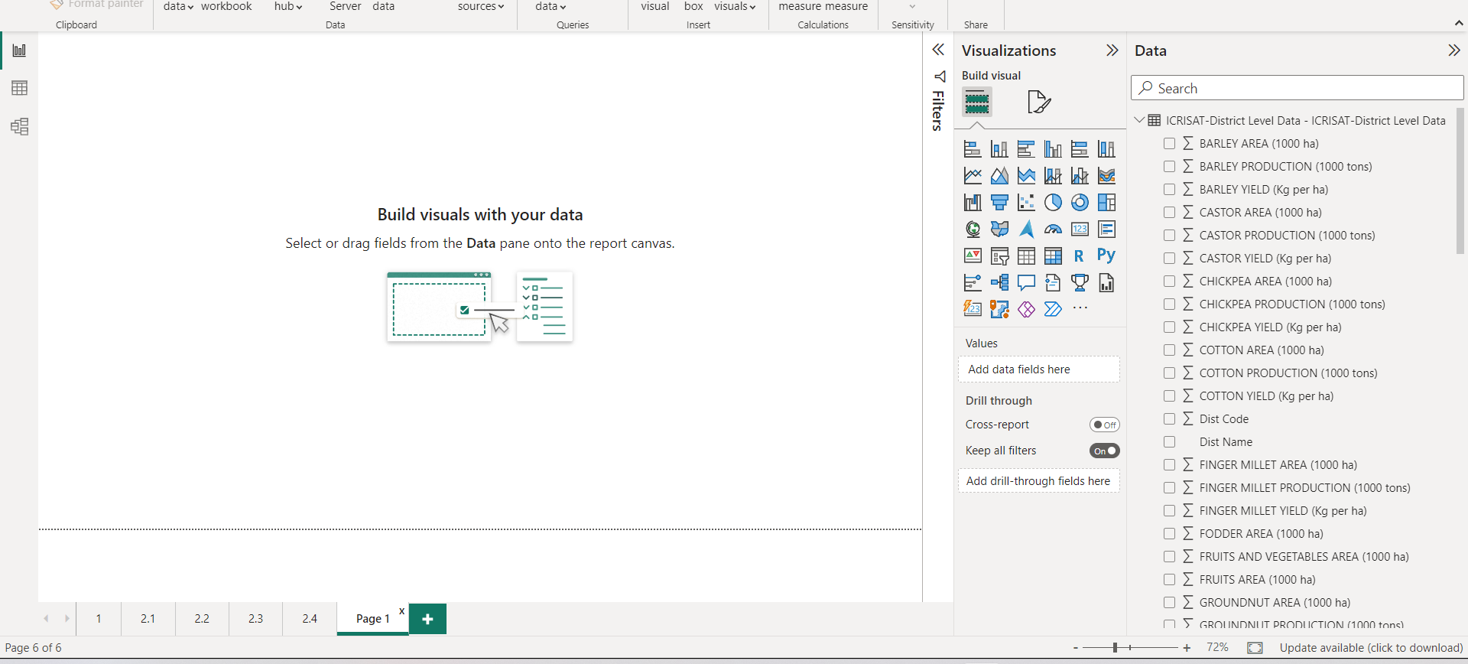

Slide 11
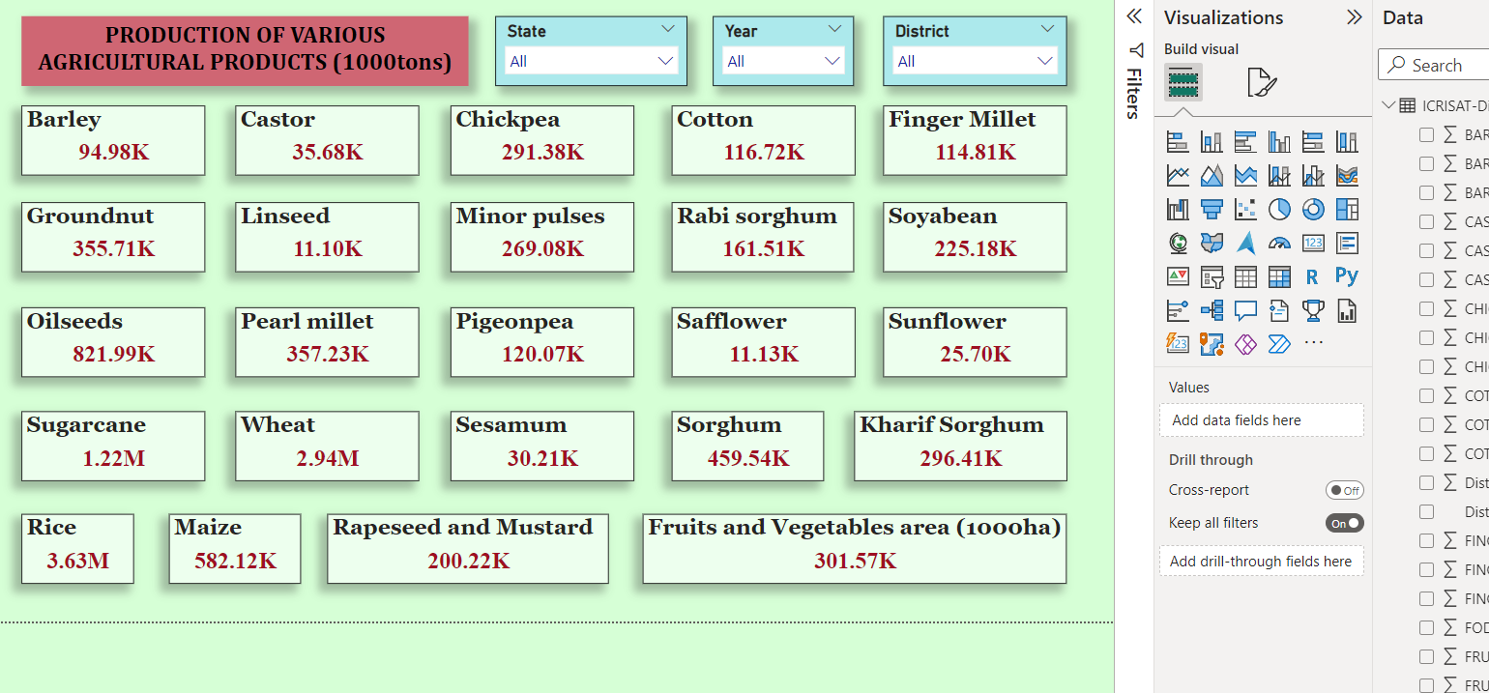

Slide 12
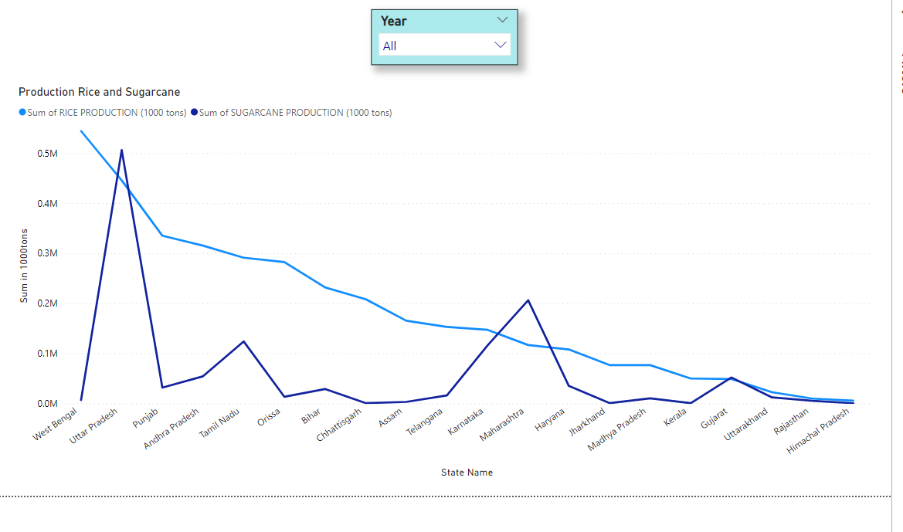

Slide 13
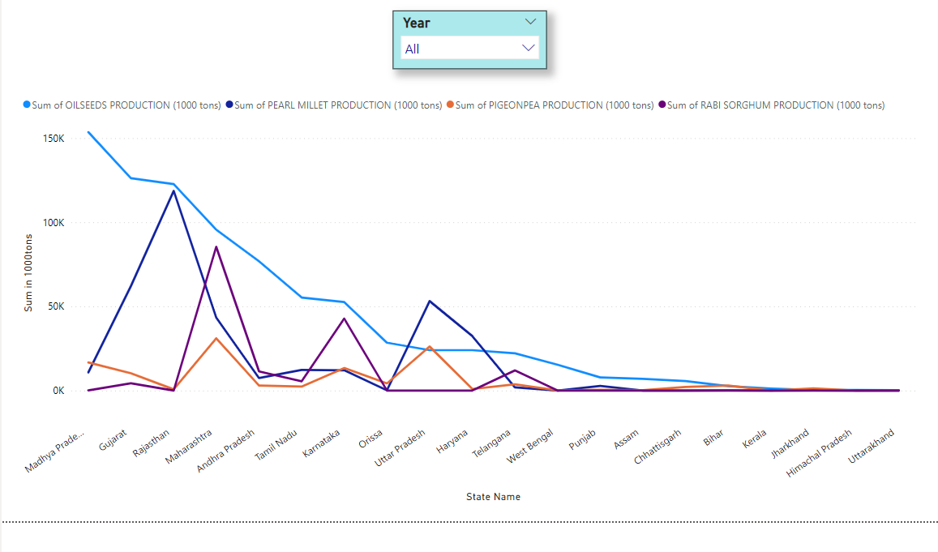

Slide 14
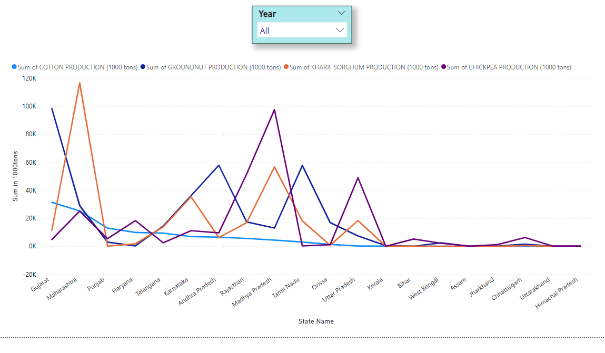

Slide 15
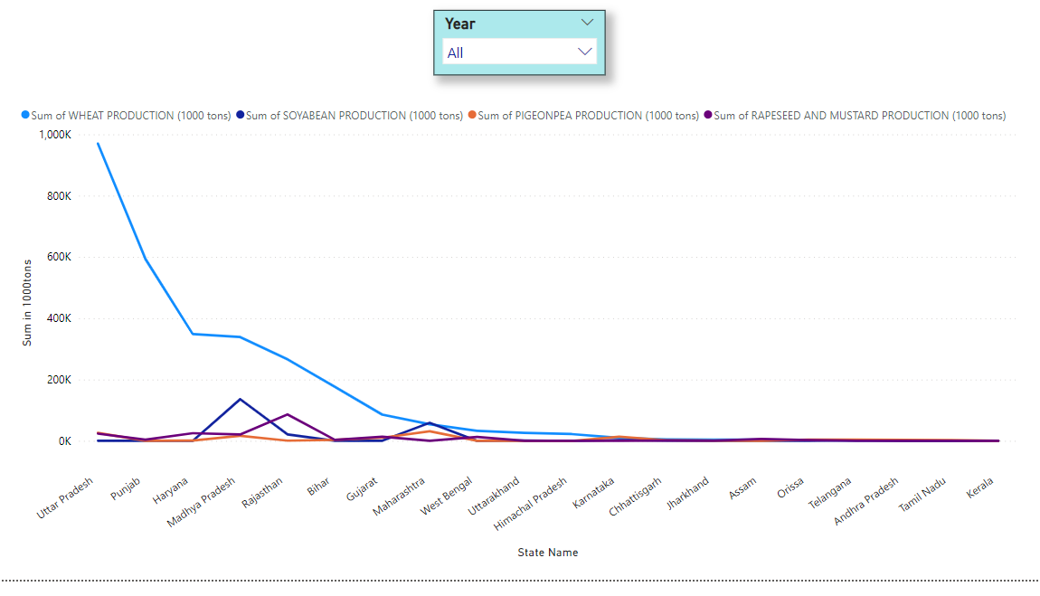

Slide 16
Policymakers and stakeholders
Crop Diversification
Sustainable Agricultural Practices
Infrastructure Development
Market Diversification and Value Addition
Climate Resilience Strategies

Slide 17
Conclusion
Through Power BI, we've gained insights into Indian agriculture, identifying trends and disparities. These findings can guide stakeholders in making informed decisions for sustainable farming practices and resource allocation. By continuing to analyze data collaboratively, we aim to drive positive change in the agricultural sector towards greater efficiency and resilience.

